Slide 1
CODE
Databases
(Panel)

Slide 2
TI (Technology information)
Data
Information

Slide 3
TI (Technology information)
Maintain
What happen?
See the past
Take pictures
Data
Information

Slide 4
Databases
Persistence
Integration
Transaction
Reporting

Slide 5
Databases
Relational databases
Oracle
Microsoft SQL Server
PostgreSQL
NoSQL
Key-Value Stores
Column-Oriented
Document Store
Graph
Search Engines

Slide 6
Relational databases
SQL (Structured Query Language)
Normalization
1NF
.
.
.
5NF
RDBMS (relational database management system)

Slide 7
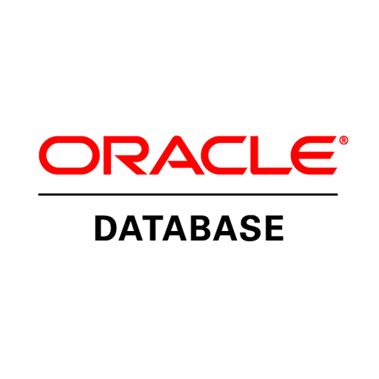
Relational databases
Oracle - Oracle Database (commonly referred to as Oracle RDBMS or simply as Oracle) is a multi-model database management system produced and marketed by Oracle Corporation.

Slide 8
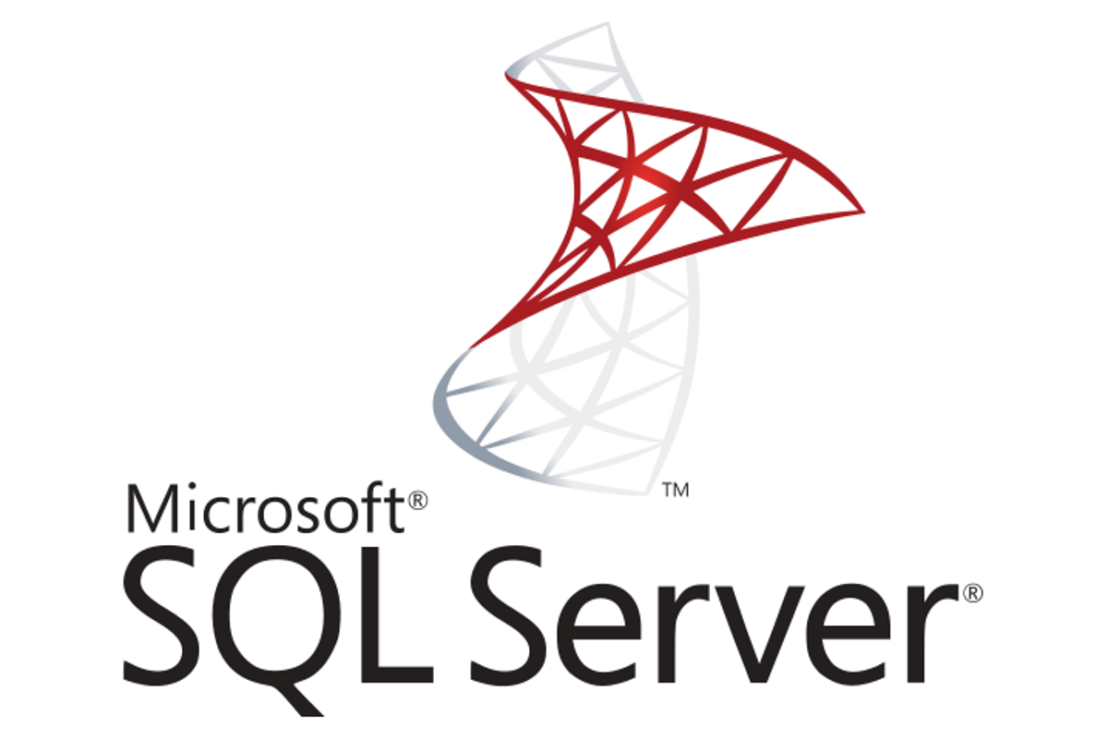
Relational databases
Microsoft SQL Server - Microsoft SQL Server is an RDBMS, that supports a wide variety of transaction processing, business intelligence and analytics applications in corporate IT environments.

Slide 9
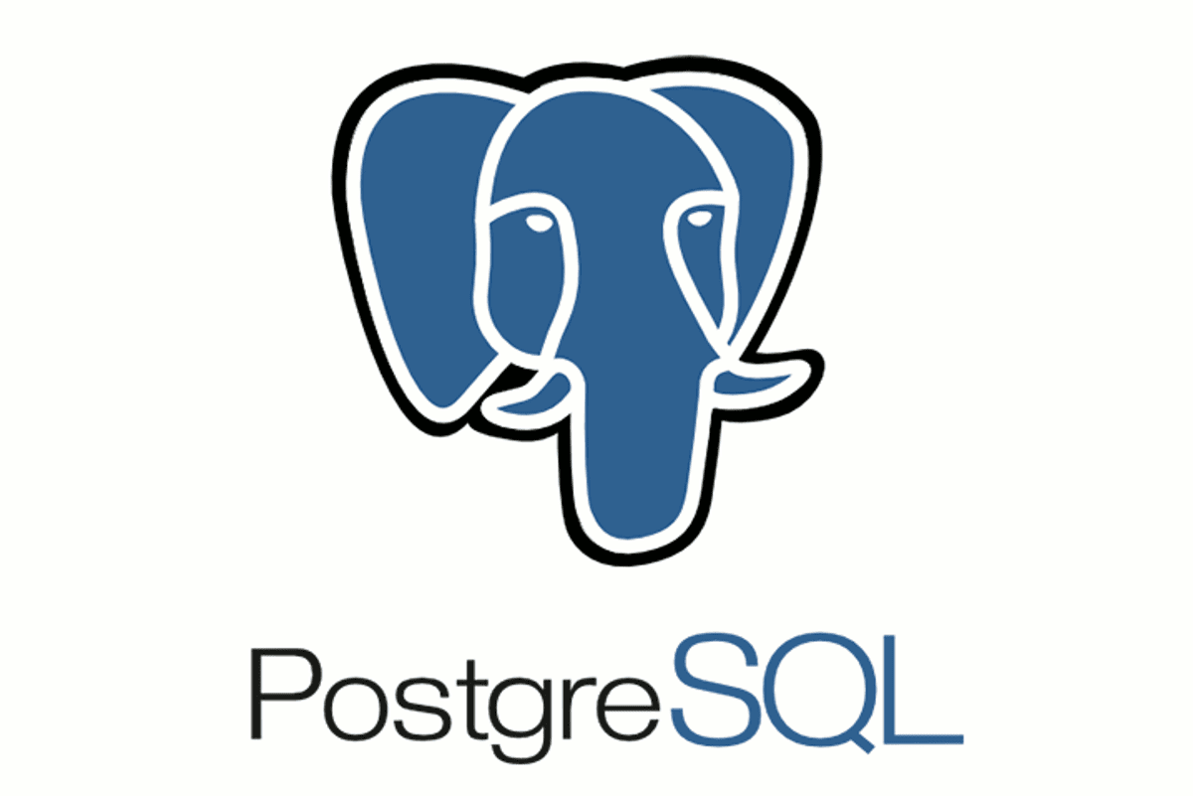
Relational databases
PostgreSQL - PostgreSQL, often simply Postgres, is an object-relational database management system (ORDBMS) with an emphasis on extensibility and standards compliance.

Slide 10
Relational databases - ORM
Object Relation Mapper
SQLAlchemy
Hibernate, EclipseLink
Entity Framework

Slide 11
ORM – Advantages
You get to write in the language you are already using anyway.
It abstracts away the database system so that switching from MySQL to PostgreSQL, or whatever flavor you prefer, is easy-peasy.
Depending on the ORM you get a lot of advanced features out of the box, such as support for transactions, connection pooling, migrations, seeds, streams, and all sorts of other goodies.
Many of the queries you write will perform better than if you wrote them yourself.

Slide 12
ORM – Disadvantages
If you are a master at SQL, you can probably get more performant queries by writing them yourself.
There is overhead involved in learning how to use any given ORM.
The initial configuration of an ORM can be a headache.
As a developer, it is important to understand what is happening under the hood.

Slide 13
Relational databases - Advantages
Relational databases are well-documented and mature technologies, and RDBMS are sold and maintained by a number of established corporations.
SQL standards are well-defined and commonly accepted.
A large pool of qualified developers have experience with SQL and RDBMS.
All RDBMS are ACID-compliant, meaning they satisfy the requirements of Atomicity, Consistency, Isolation, and Durability.

Slide 14
Relational databases - Disadvantages
RDBMSes don’t work well — or at all — with unstructured or semi-structured data, due to schema and type constraints. This makes them ill-suited for large analytics or IoT event loads.
The tables in your relational database will not necessarily map one-to-one with an object or class representing the same data.
When migrating one RDBMS to another, schemas and types must generally be identical between source and destination tables for migration to work (schema constraint). For many of the same reasons, extremely complex datasets or those containing variable-length records are generally difficult to handle with an RDBMS schema.

Slide 15
NoSQL
Non-relational databases
Cluster-friendly
Allowing unstructured
Semi-structured

Slide 16
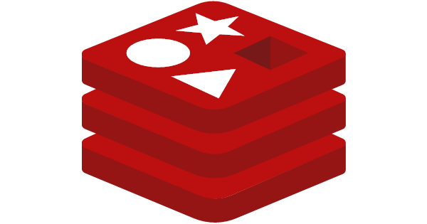
NoSQL
Key-Value Stores, such as Redis and Amazon DynamoDB, are extremely simple database management systems that store only key-value pairs and provide basic functionality for retrieving the value associated with a known key.

Slide 17
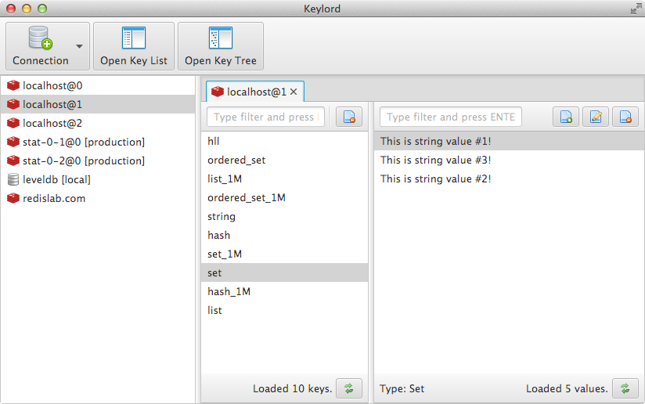
NoSQL

Slide 18

NoSQL
Document Stores, including MongoDB and Couchbase, are schema-free systems that store data in the form of JSON documents. Document stores are similar to key-value or wide column stores, but the document name is the key and the contents of the document, whatever they are, are the value.

Slide 19
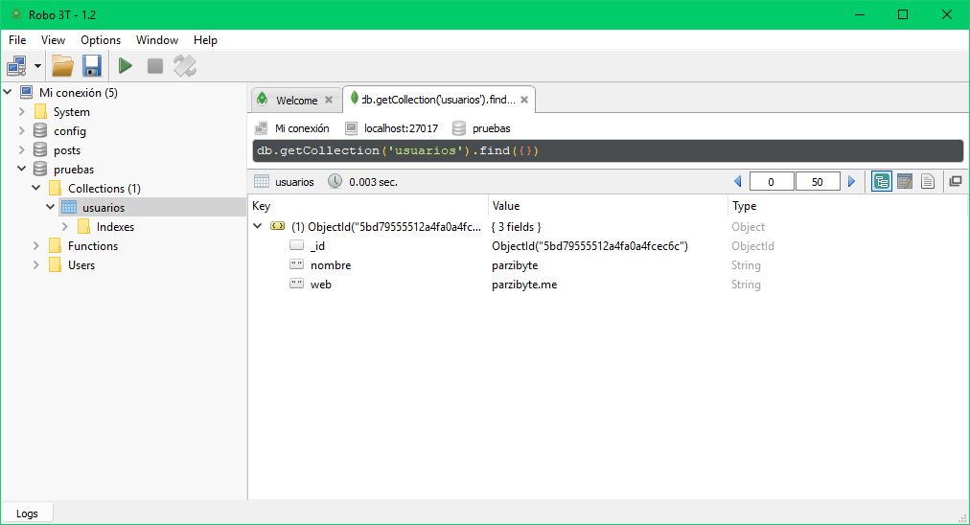
NoSQL

Slide 20

NoSQL
Column-Oriented, such as Cassandra, Scylla, and HBase, are schema-agnostic systems that enable users to store data in column families or tables, a single row of which can be thought of as a record — a multi-dimensional key-value store. These solutions are designed with the goal of scaling well enough to manage petabytes of data across as many as thousands of commodity servers in a massive, distributed system.

Slide 21
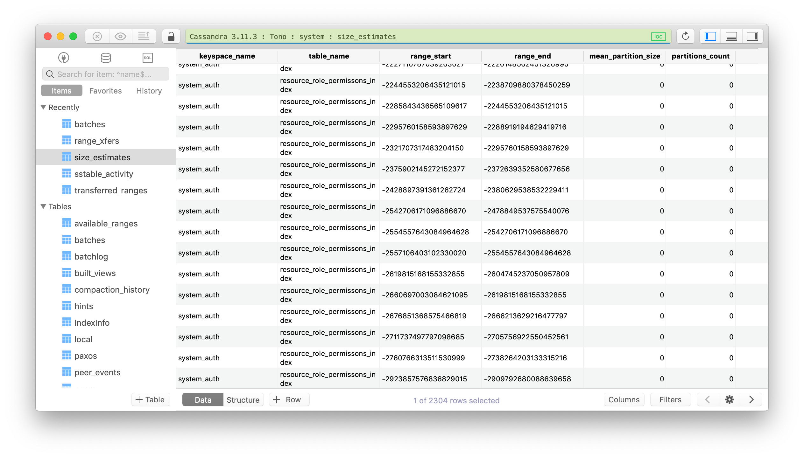
NoSQL

Slide 22

NoSQL
Graph Databases, such as Neo4J and Datastax Enterprise Graph, represent data as a network of related nodes or objects in order to facilitate data visualizations and graph analytics.

Slide 23
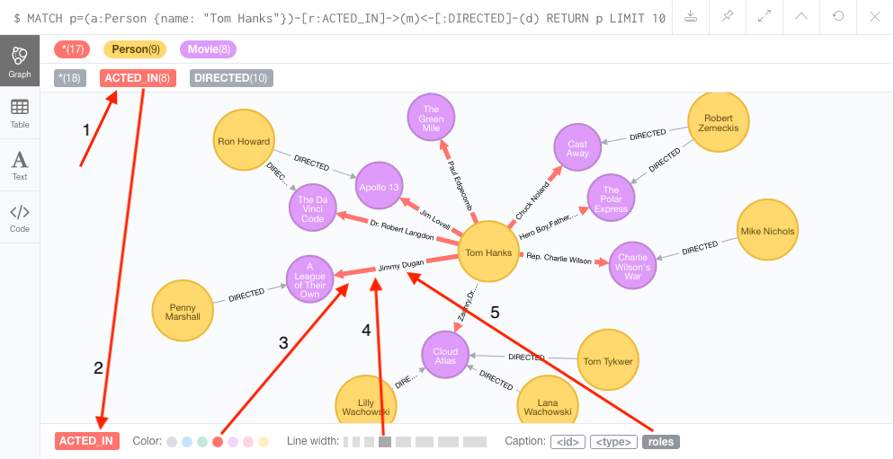
NoSQL

Slide 24

NoSQL
Search Engines, such as Elasticsearch, Splunk, and Solr, store data using schema-free JSON documents. They are similar to document stores, but with a greater emphasis on making your unstructured or semi-structured data easily accessible via text-based searches with strings of varying complexity.

Slide 25
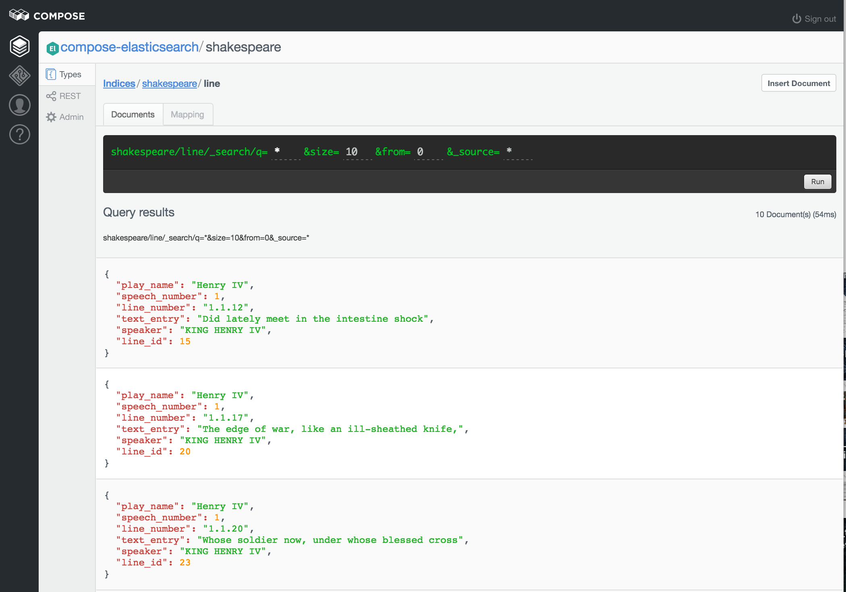
NoSQL

Slide 26
NoSQL - Advantages
Schema-free data models are more flexible and easier to administer.
NoSQL databases are generally more horizontally scalable and fault-tolerant.
Data can easily be distributed across different nodes. To improve availability and/or partition tolerance, you can choose that data on some nodes be "eventually consistent".

Slide 27
NoSQL - Disadvantages
NoSQL databases are generally less widely adopted and mature than RDBMS solutions, so specific expertise is often required.
There are a range of formats and constraints specific to each database type.

